Slide 1
DSA Mini Project
Title: Lossless File Compression using Huffman Coding

Slide 2
Name: Chandan Kumar K (PES2UG24CS128)
Dhanush Rao (PES2UG24CS153)
Gowtham L (PES2UG24CS171)
Course: B.Tech CSE
Tools Used: C Language (GCC Compiler)

Slide 3
Introduction
Data compression reduces the size of files for efficient storage and transfer.
Huffman Coding is a lossless compression algorithm — no data is lost.
It encodes frequently occurring characters using shorter binary codes.

Slide 4
Problem Statement
Create a C program to compress and decompress files using Huffman coding.
The system should:
  Build an optimal binary encoding tree.
  Encode and decode files losslessly.
  Reduce file size by ~30–50% on average.

Slide 5
Objectives
Implement lossless data compression in C.
Learn how trees and priority queues are used in real-world algorithms.
Understand bit-level file operations.
Compare original and compressed file sizes.

Slide 6
What is Huffman Coding?
Invented by David Huffman in 1952.
A variable-length encoding algorithm — frequent symbols get shorter codes.
Works by building a binary tree based on symbol frequencies.
Used in ZIP, JPEG, MP3, and many other compression systems.

Slide 7
Working Principle
Count frequency of every character.
Build a tree where lower frequency nodes are deeper.
Assign ‘0’ to the left edge and ‘1’ to the right edge.
Generate binary codes for each character.
Encode file → Write compressed output

Slide 8
System Architecture
Modules:
  Input Module (Read file & count frequency)
  Huffman Tree Construction
  Encoding Module (Bit writing)
  File Header Writer
  Decoding Module (Bit reading & tree traversal)
  Output Writer

Slide 9
Data Structures Used
Struct Node: Represents each tree node.
Struct ListNode: Linked list node used for priority queue.
Struct Code: Stores binary code for each byte.
BitReader / BitWriter: Handles bit-level file I/O.

Slide 10
Algorithm (Compression Phase)
Read input file and calculate frequency of each byte.
Build Huffman tree using linked list as a min-priority queue.
Generate Huffman codes for each symbol (recursive DFS).
Write header: magic bytes, file size, frequency table.
Encode and write compressed bitstream.

Slide 11
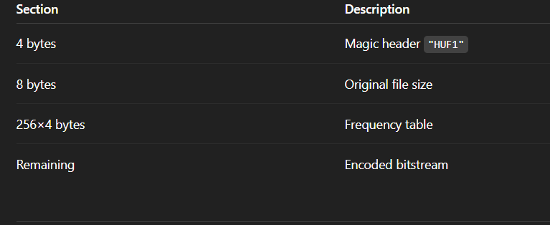
File Format Structure

Slide 12
Implementation Details
Language: C (C11 Standard)
No external libraries used.
Used fopen(), fread(), fwrite(), and bit manipulation.
Handles empty files and single-symbol files.
Fully portable across platforms (Windows/Linux).

Slide 13
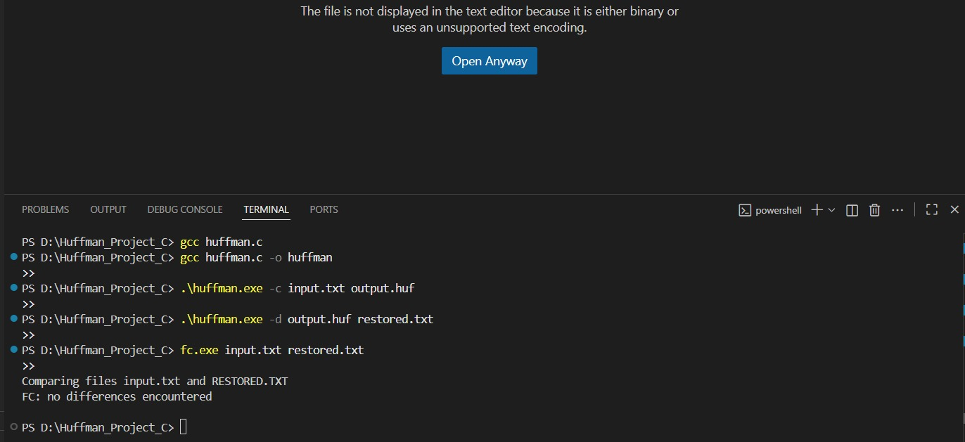
Screenshot / Demo

Slide 14
Sample Output
Original file: 600 bytes
Compressed file: 340 bytes
Compression ratio ≈ 43% reduction
Decompressed file perfectly matches the original.

Slide 15
Advantages
Efficient storage and transfer.
Simple to implement using tree and linked list.
Completely lossless (no quality loss).
Universally applicable for text and binary data.

Slide 16
Future Enhancements
Use Canonical Huffman Coding (smaller headers).
Implement Adaptive Huffman (real-time encoding).
Add GUI interface for better visualization.
Use binary heap for faster priority queue operations.

Slide 17
Applications
ZIP and RAR file compression.
JPEG image compression.
MP3 and MPEG audio/video encoding.
Data transmission and network optimization.

Slide 18
Conclusion
Huffman coding provides an elegant, lossless, and efficient method of compression.
Demonstrated practical use of trees, linked lists, and bit manipulation in C.
The project deepened understanding of data structures and algorithms.

